Slide 1
Airbnb Insight Vault
CAPSTONE PROJECT
- Vishwajeet Pawar

Slide 2
CONTENTS
1
Introduction
2
Goal
3
Tools
4
Workstreams
5
Visualization
6
Dashboard
7
Future scope

Slide 3
Introduction
Detailed information of problem statement and dataset

Slide 4
Introduction
Problem Statement:
Conduct a geographic analysis of Airbnb listings to identify patterns and trends in pricing, locations and review scores across different cities and neighborhoods
Objective:
To visualize and understand the spatial distribution of listings, and property type preferred by customers
How factors like communication, cleanliness, prices influencing review scores

Slide 5
Goal

Slide 6
Goal
Visualize Geographic Distribution
Analyze Pricing Trends by Location
Examine Review Scores by Location
Identify Preferred Property Types by Location
Analyze the Relationship Between Review Scores and Pricing

Slide 7
Tools
Tools used to do all tasks

Slide 8






Tools
01
SQL Database
02
03
04
05
Cosmos DB
Data Factory
Databricks
Blob Storage/ Datalake

Slide 9
Workstream
Brief of workflow and screenshots of all workflow

Slide 10
Workstream
Flow
GitHub
Datalake
SQL
Azure DF
Cosmos
Databricks
(ETL)
SQL
Databricks
(Visualization)
Blob storage

Slide 11
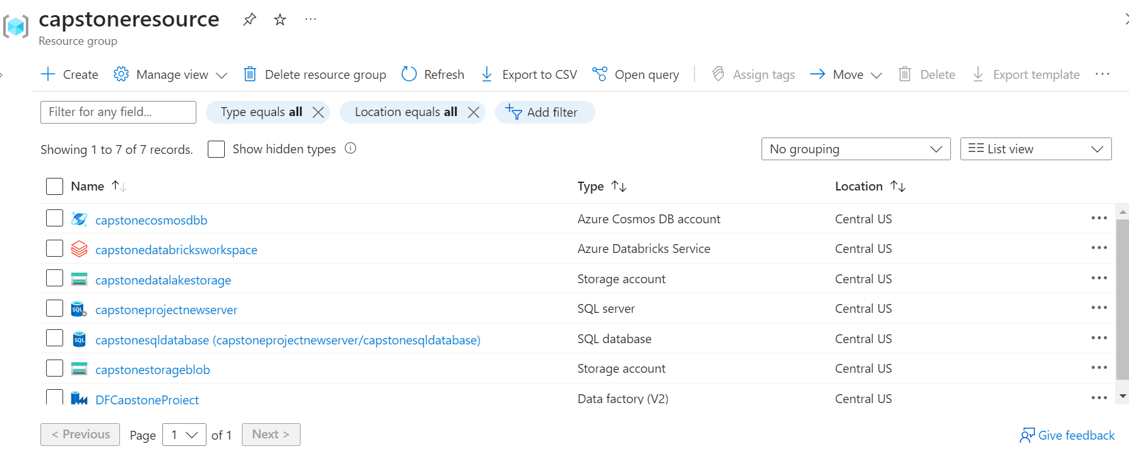
Resource Group

Slide 12

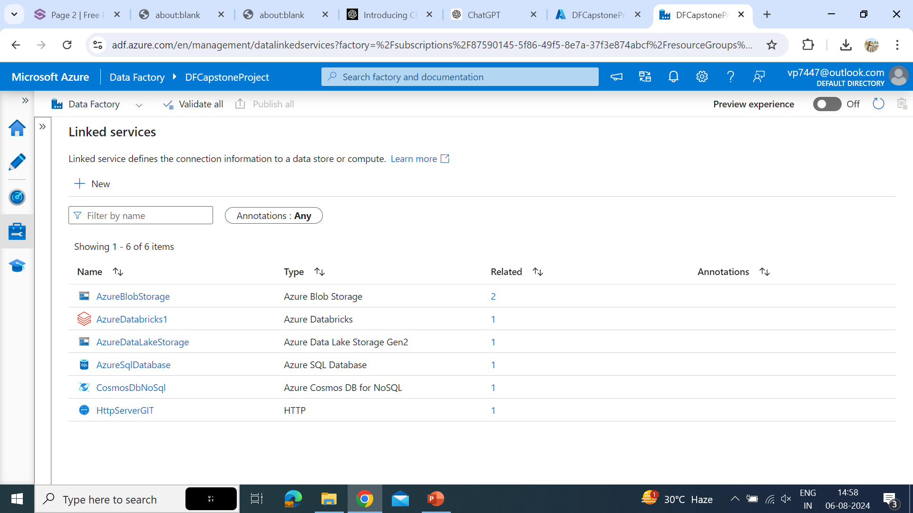
Linked Services

Slide 13
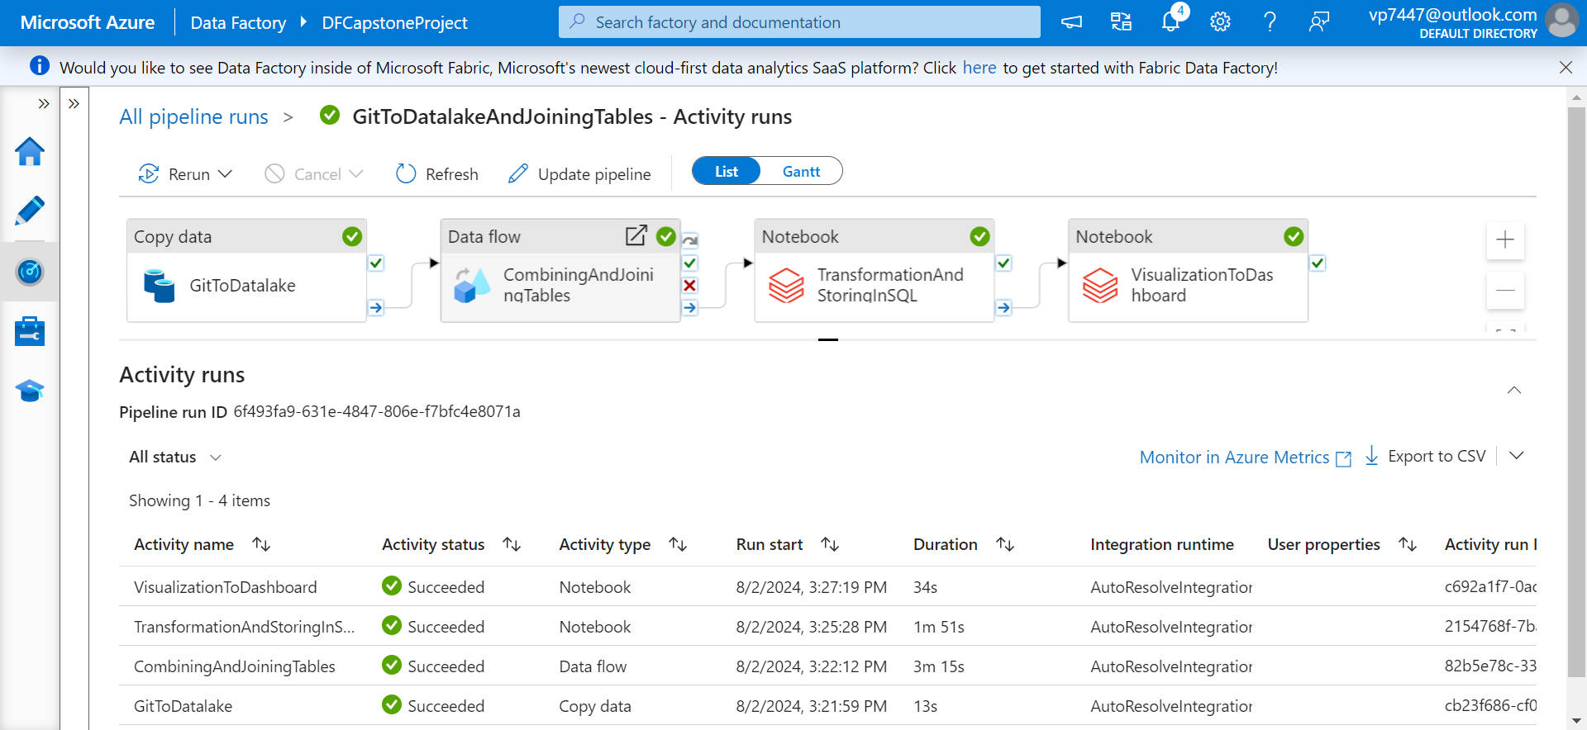
Pipeline

Slide 14
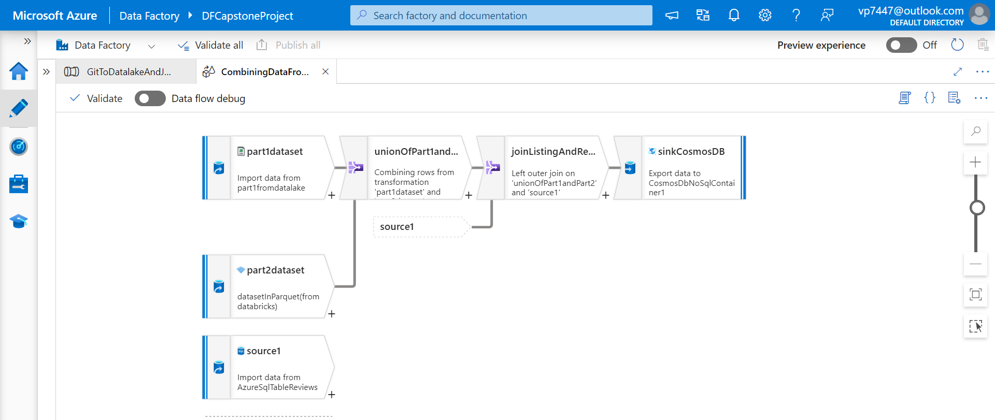
Dataflow

Slide 15
Transformation
Changes and optimization techniques performed on the dataset

Slide 16
Transformation
Datatype Handling
Changing Data
host_is_superhost, host_has_profile_pic, host_identity_verified, instant_bookable
Dropping Columns
host_response_time, host_response_rate, host_acceptance_rate, district, id
Drop Nulls
Drop Duplicates

Slide 17
Visualization
Screenshots of visualization performed on the dataset

Slide 18
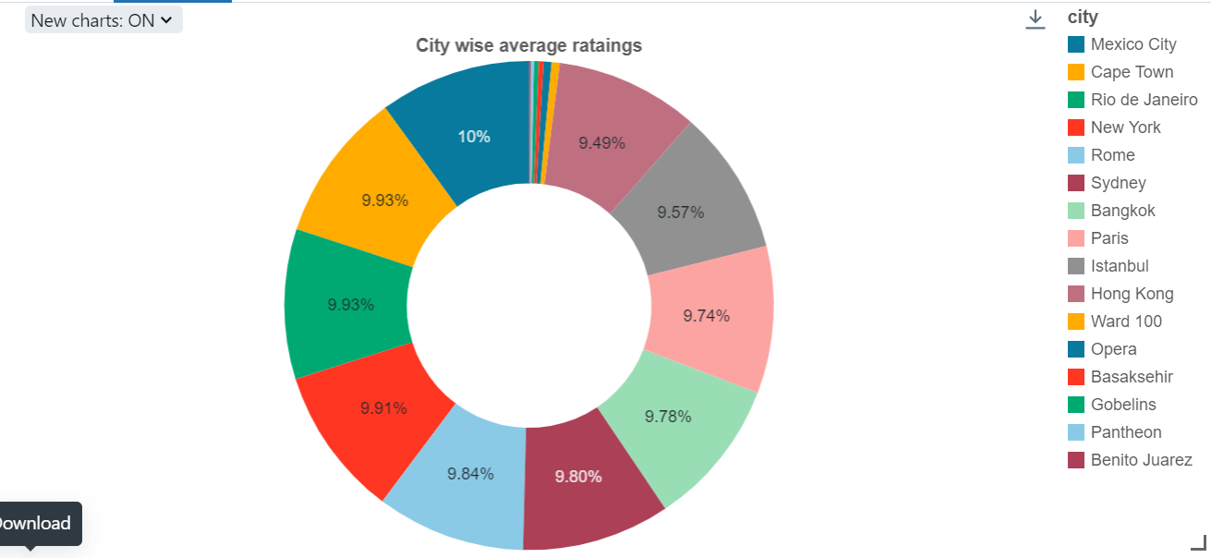
Visualization

Slide 19
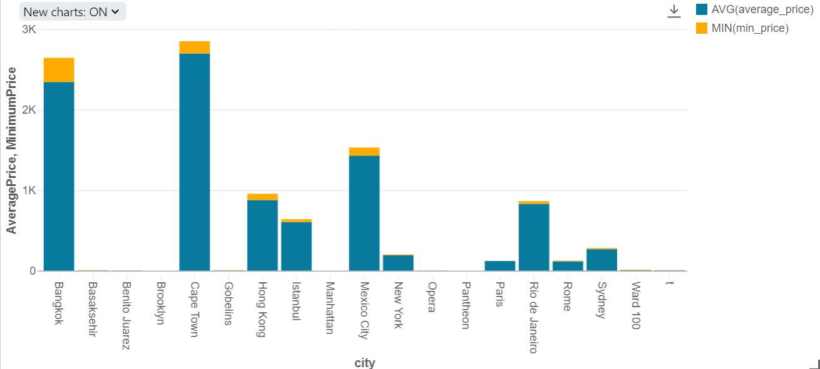
Visualization

Slide 20
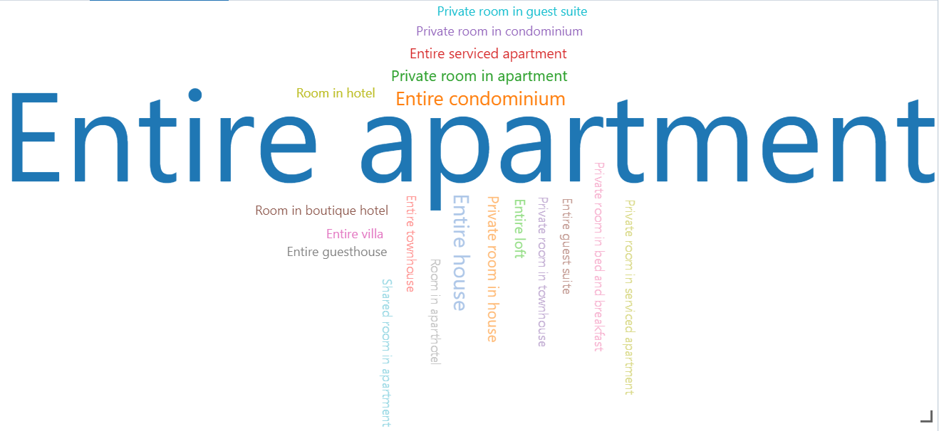
Visualization

Slide 21
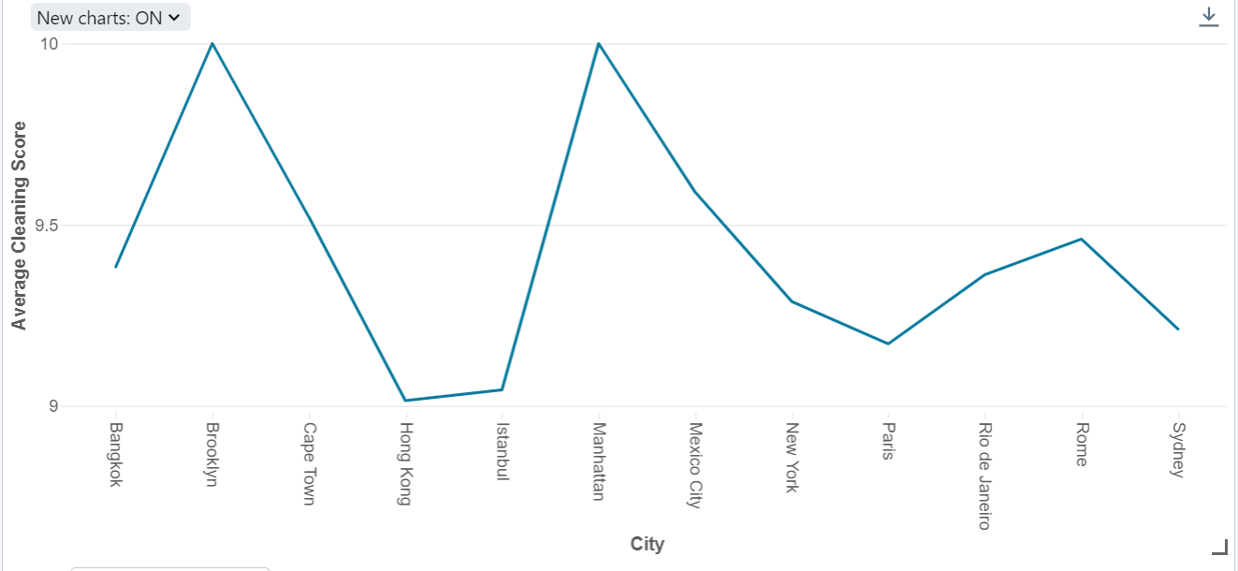
Visualization

Slide 22
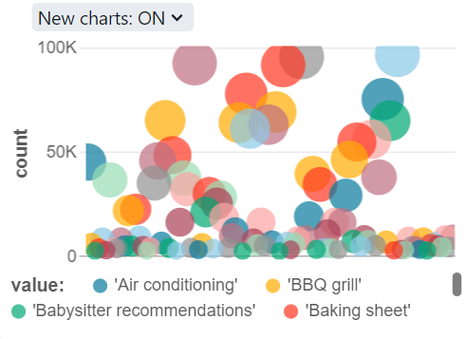
Visualization

Slide 23
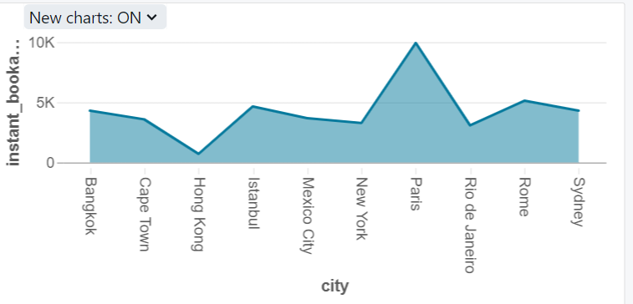
Visualization

Slide 24
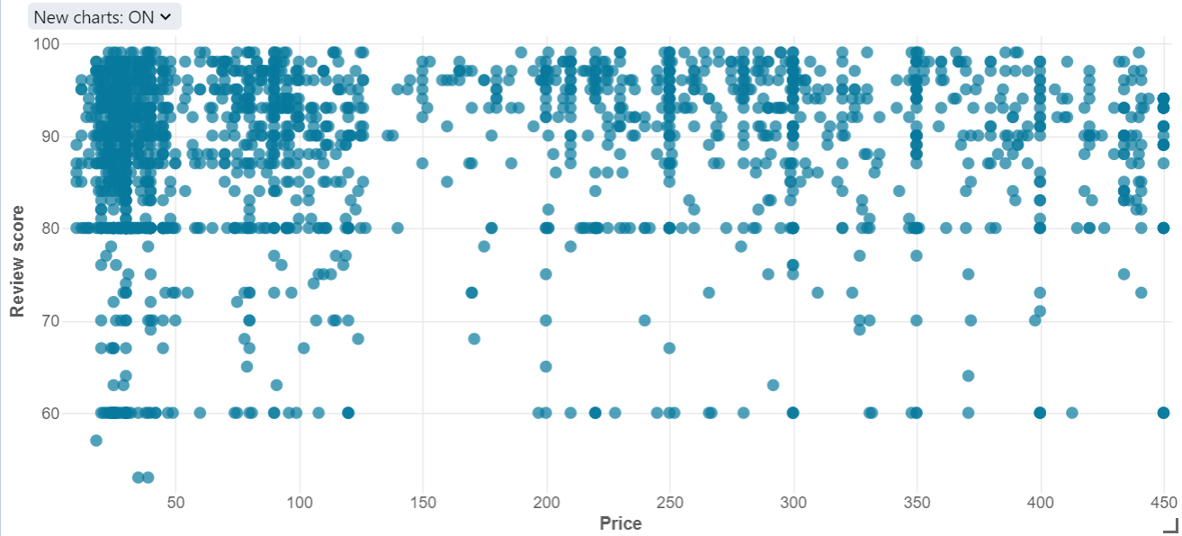
Visualization

Slide 25
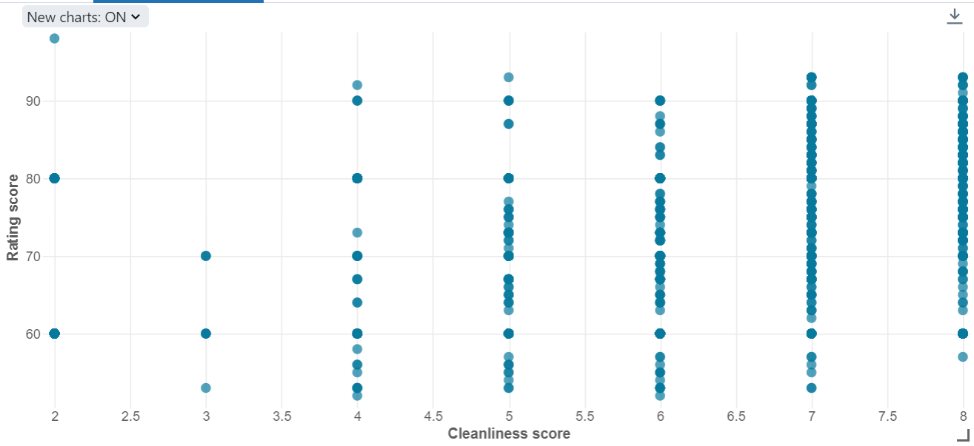
Visualization

Slide 26
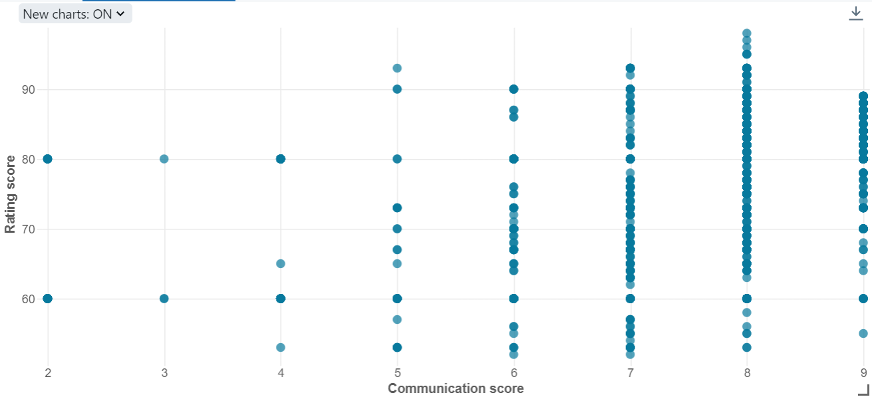
Visualization

Slide 27
Dashboard
Screenshots of databrick’s dashboard of visualization performed on the dataset

Slide 28
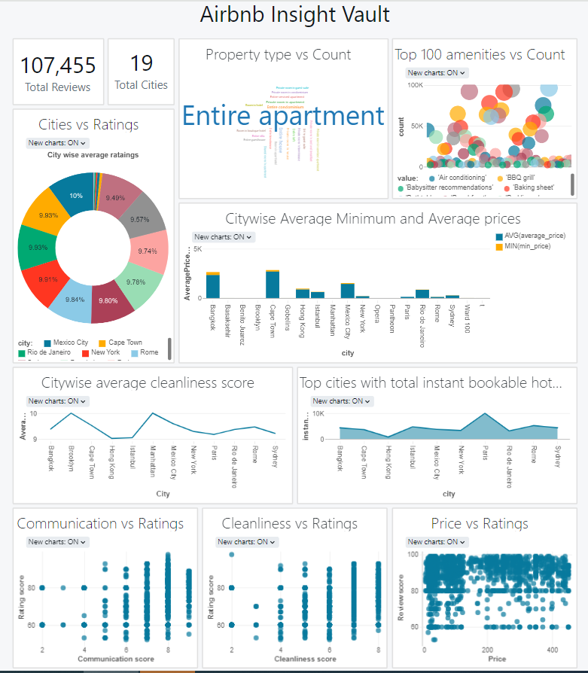
Dashboard

Slide 29
Future Scope
Areas for further exploration

Slide 30
Future Scope
Enhanced Geographic Analysis
Micro-trends and regional patterns within cities
Dynamic Pricing Models
Changes in pricing impact booking rates and review scores
Integration with Booking and Reservation Data
Booking sources, and cancellation rates, to understand booking behavior and improve reservation strategies

Slide 31
THANK YOU

